Slide 1
Concurrency:
Mutual Exclusion and Synchronization
Chapter 5

Slide 2
Concurrency issues
Communication among processes
Sharing resources
Synchronization of multiple processes
Allocation of processor time
Difficulties with Concurrency
Facilitate sharing of global resources
Management of allocation of resources
Programming errors difficult to locate

Slide 3
Operating System Concerns
Deadlock
Allocation/deallocation of resources
  Processor time
  Memory
  Files
  I/O devices
Protection of data and resources
Synchronization (support for mutual exclusion)
Result of a process must be independent of the speed of execution of other concurrent processes

Slide 4
Requirements for Mutual Exclusion
Only one process at a time is allowed in the critical section for a resource
A process that halts in its non-critical section must do so without interfering with other processes
No deadlock or starvation
A process must not be delayed access to a critical section when there is no other process using it
A process remains inside its critical section for a finite time only
No assumptions are made about relative process speeds or number of processes

Slide 5
Mutual Exclusion: Hardware Support
Interrupt Disabling
  Disabling interrupts guarantees mutual exclusion
    Disadvantages
    Processor is limited in its ability to interleave programs
    In a Multiprocessor system, disabling interrupts on one processor will not guarantee mutual exclusion
    A user process can easily abuse this privilege and hence should not be available to a user process.

Slide 6
Mutual Exclusion: Hardware Support
Special Machine Instructions
  Performed in a single instruction cycle
  Not subject to interference from other instructions
  Reading and writing
  Reading and testing

Slide 7
Mutual Exclusion: Hardware Support
Test and Set Instruction
boolean testset (int i) {
if (i == 0) {
i = 1; /* lock it */
return true;
}
else {
return false;
}
}

Slide 8
Semaphores
Special variable called a semaphore is used for signaling
If a process is waiting for a signal (lock), it is suspended until that signal (lock) is delivered
Queue is used to hold processes waiting on the semaphore

Slide 9
Semaphores
Semaphore is a variable that has an integer value
  May be initialized to a nonnegative number
  Wait operation decrements the semaphore value
  Signal operation increments semaphore value
Wait() and signal() operations cannot be interrupted

Slide 10
Semaphores
struct semaphore {
int count;
queueType queue;
}
void wait(semaphore s)
{ s.count--;
if (s.count < 0)
{place this process in s.queue;
block this process
}
}
void signal(semaphore s)
{
s.count++;
if (s.count <= 0)
{ remove a process P from s.queue;
place process P on ready list;
}
}
wait( ) ≡ P( )
signal( ) ≡ V( )

Slide 11
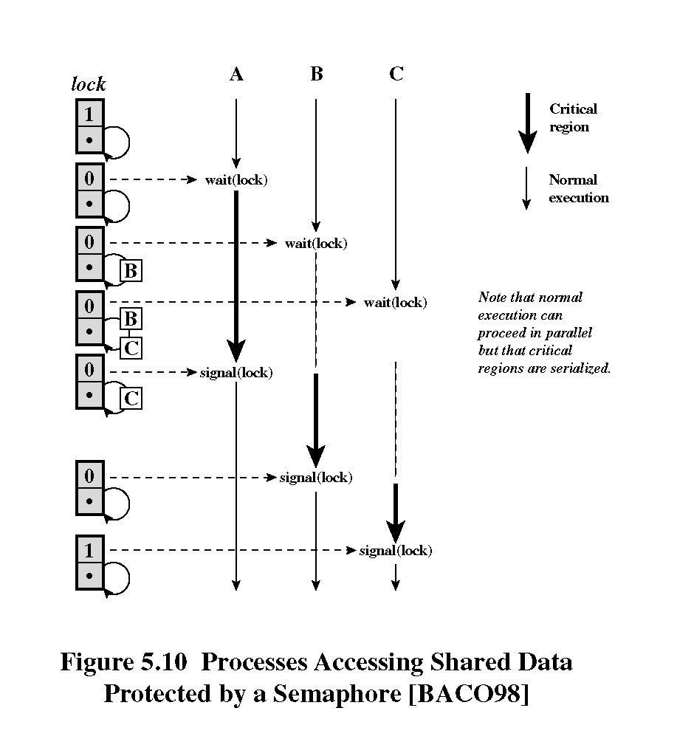
Semaphore/Critical Section example

Slide 12
Producer/Consumer Problem
One or more producers are generating data and placing these in a buffer
A single consumer is taking items out of the buffer one at time
Only one producer or consumer may access the buffer at any one time

Slide 13
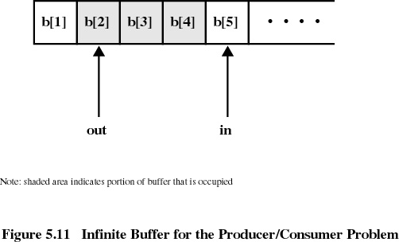
Infinite Buffer

Slide 14
Producer
producer:
while (true) {
/* produce item v */
b[in] = v;
in++;
}

Slide 15
Consumer
consumer:
while (true) {
while (in <= out)
/* do nothing = wait */;
w = b[out];
out++;
/* consume item w */
}

Slide 16
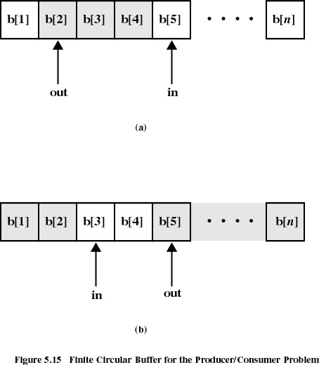

Slide 17
Producer with Circular Buffer
producer:
while (true) {
/* produce item v */
while ((in + 1) % n == out)
/* do nothing */;
b[in] = v;
in = (in + 1) % n
}

Slide 18
Consumer with Circular Buffer
consumer:
while (true) {
while (in == out)
/* do nothing */;
w = b[out];
out = (out + 1) % n;
/* consume item w */
}

Slide 19
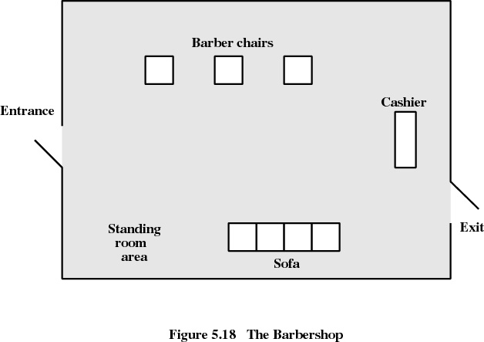
Barbershop Problem

Slide 20
The Barbershop
/* program barbershop1 */
semaphore max_capacity = 20, sofa = 4, barber_chair = 3, coord = 3;
semaphore cust_ready = 0, finished = 0, leave_b_chair = 0, payment= 0, receipt = 0;
void customer ()
{wait(max_capacity);
enter_shop();
wait(sofa);
sit_on_sofa();
wait(barber_chair);
get_up_from_sofa();
signal(sofa);
sit_in_barber_chair;
signal(cust_ready);
wait(finished);
leave_barber_chair();
signal(leave_b_chair);
pay();
signal(payment);
wait(receipt);
exit_shop();
signal(max_capacity)
}
void barber()
{
while (true)
{
wait(cust_ready);
wait(coord);
cut_hair();
signal(coord);
signal(finished);
wait(leave_b_chair);
signal(barber_chair);
}
}

Slide 21
Barbershop cont.
void cashier()
{
while (true)
{
wait(payment);
wait(coord);
accept_pay();
signal(coord);
signal(receipt);
}
}
void main()
{
parbegin (customer, . . . 50 times, . . . customer, barber, barber, barber, cashier);
}

Slide 22
Readers/Writers Problem
Any number of readers may simultaneously read the file
Only one writer at a time may write to the file
If a writer is writing to the file, no reader may read it

Slide 23
Readers-Writers Problem
Reader
Writer
Reader
Writer
Reader
Writer
Reader
Writer
Reader
Writer
Reader
Writer
Reader
Writer
Reader
Shared Resource

Slide 24
Readers-Writers Problem
Writer
Writer
Writer
Writer
Writer
Writer
Writer
Reader
Reader
Reader
Reader
Reader
Reader
Reader
Reader
Shared Resource

Slide 25
Readers-Writers Problem
Reader
Writer
Reader
Writer
Reader
Writer
Reader
Writer
Reader
Writer
Reader
Writer
Reader
Reader
Writer
Shared Resource

